Slide 1
LabVIEW Lesson Day2
Joe Kao
Application engineer, eCloudValley
2021/1/25

Slide 2
Communicating Data Between Parallel Loops
Develop code that synchronizes data between parallel loops.
Introduction
Queues
Notifiers
Summary
Notes:
這一章要介紹在平行迴圈中傳遞資料的方法
也就是我們說的Producer/Consumer Loop 常見的架構就是Queue, Notifier
分別介紹2種架構的特性 以及最後會有一個綜合比較

Slide 3
A. Introduction
Review using local variables to communicate between parallel loops.
Notes:
要在2個平行迴圈中傳遞資料最直觀的想法會是Local Variable Local Variable雖然也可以在平行迴圈中傳遞資料 但是會有一些潛在的意外
A節5分

Slide 4
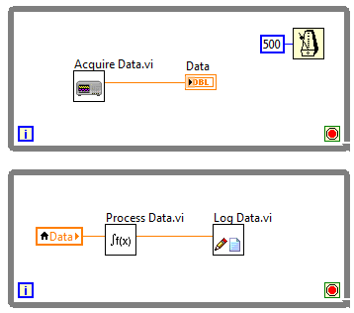
Communicating Data Between Parallel Loops – Local Variables
Local variables share the latest data between parallel loops.
Notes:
為何要使用兩個平行迴圈? 可以同步(同時、平行) 可以用不同的速率執行
如果在平行迴圈架構下，使用local variable傳遞stop按鈕的資料是可行的，因為我們只需要知道“最後一筆stop的資料”
重點：最後－最新的資料 只需要對最新的資料有反應 前面的資料是甚麼不重要
因為沒有明確定義先後順序 所以會發生Race Condition 也就是說我們並不知道寫入和讀取哪一個先發生 有可能會讀到重複的資料 有可能會資料會被覆蓋而遺失
我們將會無法掌握資料
因為local variable只會傳遞最新的資料，所以若是不想要遇到以上兩個問題，我們可以使用下一個章節所學習的_queue

Slide 5
Exercise Producer/Consumer Loop with Local Variable
建立二個平行的While Loop，上面為Producer Loop，下面為Consumer Loop
在Producer Loop放置亂數產生器，連接上Indicator，並建立Indicator的Local Variable
將Local Variable 放入Consumer Loop，Change to Read後連接上另一個Indicator
Run VI，觀察二個Indicator的數值

Slide 6
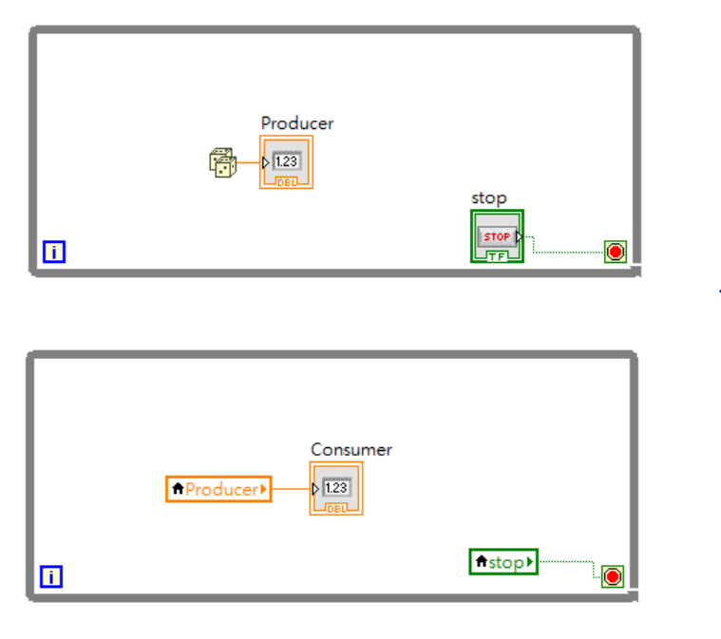
Exercise Producer/Consumer Loop with Local Variable

Slide 7
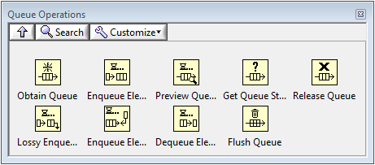
B. Queues
Demonstrate how to transfer every point of data between parallel loops using queues.
Notes:
只能將資料傳遞給1個Consumer Loop
基本常用的有Obtain Queue, Enqueue, Dequeue, Get queue status(Queue中有多少element), Release Queue

Slide 8
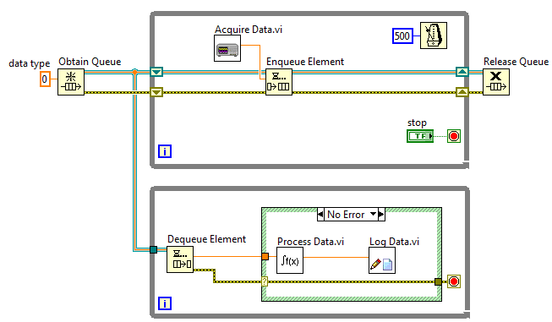
Communicating Data Between Parallel Loops – Queues
Transfer every point of data between parallel loops or VIs
Notes:
FIFO特性 資料會依照寫入順序依序讀出
Buffer可以暫存資料 資料不會在傳遞過程中遺失 Producer/Consumer可以用不同速度執行 實驗為例
Queue可以做到local variable做不到的事情
Obtain queue產生了queue的reference, 然後把reference傳遞給enqueue和dequeue，這只是reference並不是資料流

Slide 9
Exercise Make a Queue Structure
建立2個While Loop (Producer and Consumer)
設置Obtain Queue, Enqueue, Dequeue, Get queue status
Producer 放入亂數產生
Consumer 讀出亂數
Notes:
不要放Time Delay

Slide 10
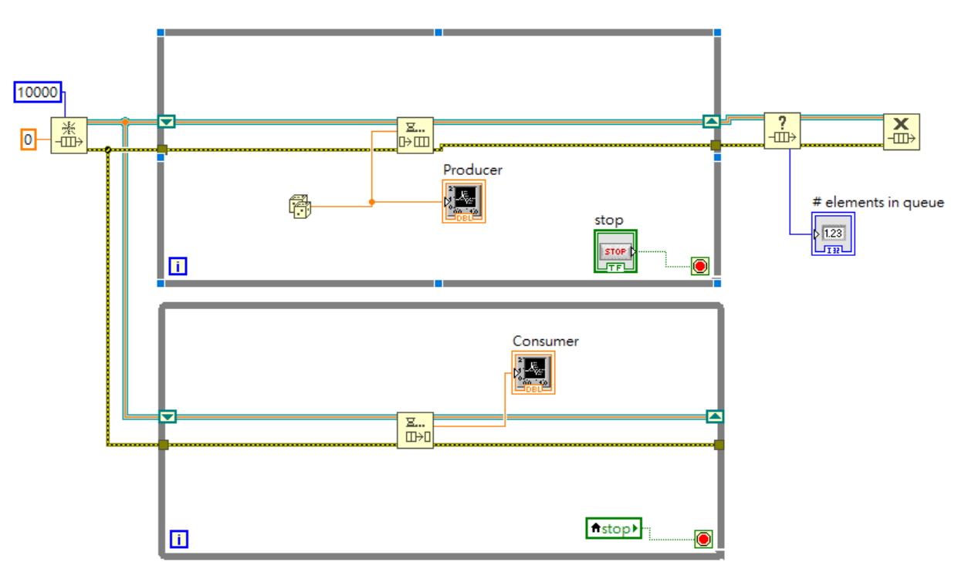
Exercise Make a Queue Structure

Slide 11
C. Notifiers
Create code that broadcasts the latest data to waiting parallel loops using notifiers.
Notifiers Operations Palette
Using Notifiers
Notes:
Notifier可以將資料傳給多個Slave Loop
Notifier和Queue不同的是它只傳遞最後一筆資料

Slide 12
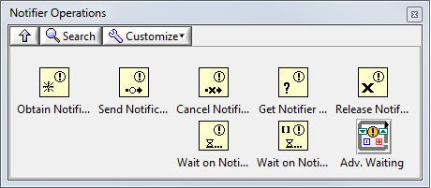
What is a Notifier?
Notifier functions—Suspend the execution of a block diagram until it receives data from another section of the block diagram or from another VI running in the same application instance
Notes:
暫停程式直到接收到資料才開始運作
Wait on Notifier和dequeue一樣，都是接收資料。

Slide 13
Notifiers vs. Queues
Notifiers do not buffer data, so receiving loops only receive the latest notification
Notifiers can broadcast a notification to multiple loops
Notes:
Notifier沒有buffer 所以只會傳遞最後一筆資料
但是Notifier可以用來傳遞給多個consumer迴圈

Slide 14
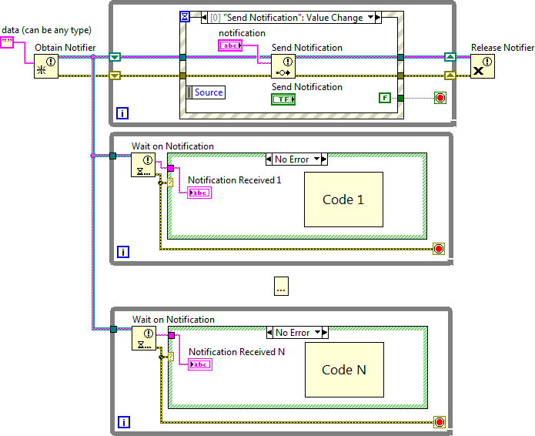
Broadcast Data to Parallel Loops
Notes:
架構上和queue很類似，都是屬於Producer/Consumer的Design Pattern 因為沒有Buffer 所以當執行速度非常快的時候可能資料會被覆蓋掉
Producer loop 會把資料廣播到各個Consumer Loop

Slide 15
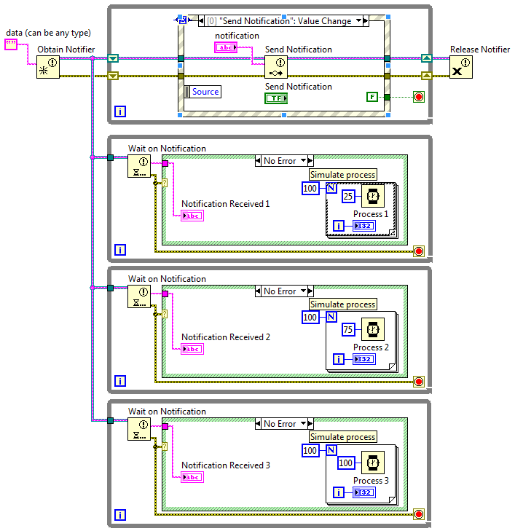
Demonstration Notifier
Broadcast the latest data to waiting parallel loops.
Notes:
Location: <Exercises>\Demonstrations\Notifiers\Notifier scenario.vi
.[跑的速度不一樣，所以更新速度不同] [跑完執行時間才會停止]
在處理的時候如果有丟出資料就會遺失][也就是只有最新的資料] 如果你不傳出資料，下面的slave迴圈就會等待
如果你的master 迴圈傳遞太快，slave迴圈就有可能失去資料

Slide 16
Exercise Make a Notifier Structure
建立2個While loop
放置Obtain Notifier, Send Notification, Wait on Notification.(Producer and Consumer Loop)
Producer loop 輸出亂數
Consumer loop接收Producer loop 的資料
Notes:
Example “Simple Notifier”
會遺失資料點

Slide 17
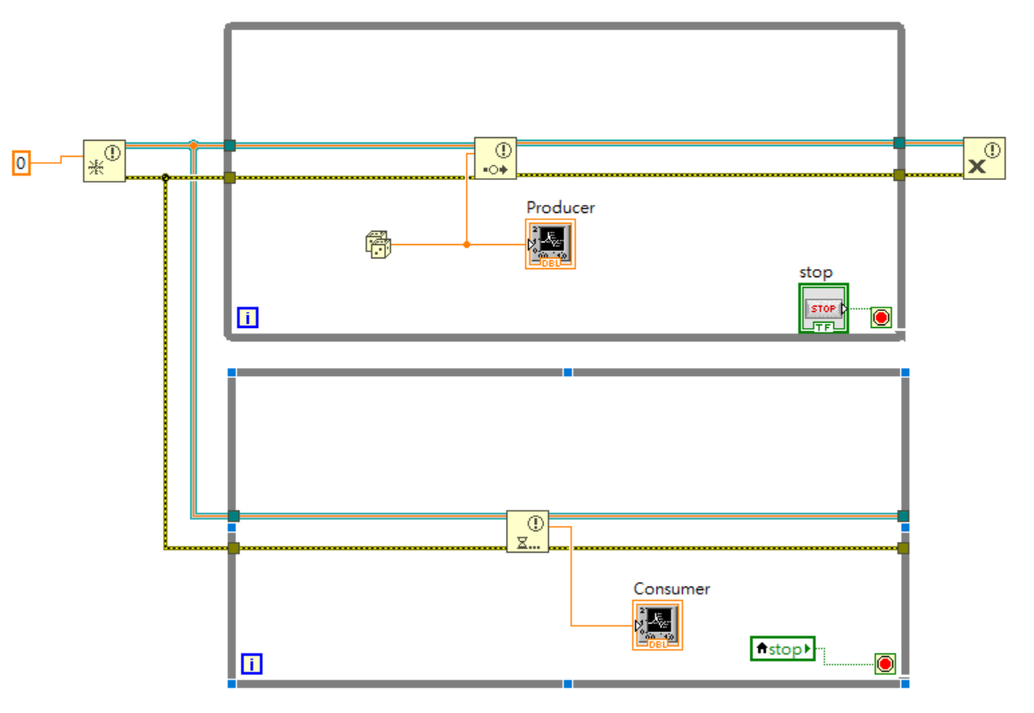
Exercise Make a Notifier Structure

Slide 18
D. Summary
Compare Variables, Queues, and Notifiers
 | Suspend execution in reader loop? | Buffers data? | Data can be read by multiple loops? | Use case
Local/global variables |  |  | Yes | Transfer latest data
Queues | Yes | Yes |  | Transfer every point of data
Notifiers | Yes |  | Yes | Transfer latest data to multiple loops that are waiting on a notification
Notes:
Walk through the table and emphasize the appropriate use case for each of these methods
請學生說出他們有哪些應用可能會用到兩個迴圈，而這些平行迴圈的應用又比較適合使用哪一種傳遞方式? Question: Can someone describe an example of when they might use a local/global variable in their application? Question: Can someone describe an example of when they might use queues in their application? Question: Can someone describe an example of when they might use notifiers in their application?
Answers: As the instructor, help students determine if their example is appropriate. If students do not need to create an application with parallel loops, then they do not have to use any of these methods

Slide 19
Which of the following buffer data?
Queues
Notifiers
Local Variables

Slide 20
Which of the following buffer data?
Queues
Notifiers
Local Variables

Slide 21
Match the following:
Obtain Queue
Get Queue Status
Release Queue
Enqueue Element
a. Destroys the queue reference
b. Assigns the data type of the queue
c. Adds an element to the back of a queue
d. Determines the number of elements currently in the queue
Notes:
BDAC

Slide 22
Match the following:
Obtain Queue
Get Queue Status
Release Queue
Enqueue Element
b. Assigns the data type of the queue
d. Determines the number of elements currently in the queue
a. Destroys the queue reference
c. Adds an element to the back of a queue

Slide 23
Implementing Design Patterns
Implement common design patterns for single and parallel loop applications.
A. Why Use Design Patterns?
B. Simple Design Patterns
C. Multiple Loop Design Patterns
D. Functional Global Variable Design Pattern
Error Handlers
Notes:
這一章要介紹常用的Design Pattern 包含Simple, Multi Loop, Functional Global Variable (FGV)

Slide 24
A. Why Use Design Patterns?
Design Patterns—Code implementations and techniques that are solutions to specific problems in software design
Design Patterns:
Evolve through the efforts of multiple developers
Fine-tuned for simplicity, maintainability, and readability
Notes:
Design pattern是經過長時間演進產生的標準程式架構 已經被時間證明是有效的了
使用既有的Design Pattern可以幫助其他人（包含你自己）看懂、維護以及修改你的程式
可以降低維護的時間成本

Slide 25
B. Simple Design Patterns
Describe and use simple design patterns.
Simple VI
General VI
State Machine
Event-Based State Machine
Notes:
包含Simple, General, State Machine, Event-Based State Machine四種
等等會依序介紹

Slide 26
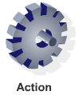
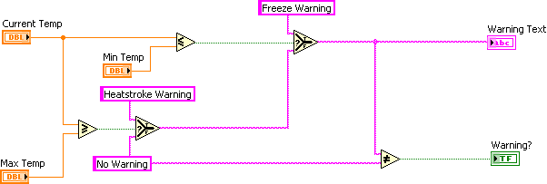
Simple VI Pattern
Notes:
Simple VI Pattern
單純由左向右執行 一般來說這樣的VI只會做簡單的事情，例如做一個量測、做計算以及顯示結果和寫入檔案 通常不需要一個特別指定的開始或stop的動作 架構只會執行單一的行為 簡單的應用可以使用這樣的架構，一個時間只執行一個

Slide 27
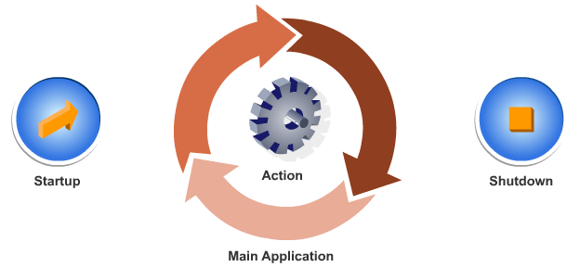
General VI Pattern
Notes:
General VI Pattern This pattern has three phases: • Start-up • Main application • Shut-down

Slide 28
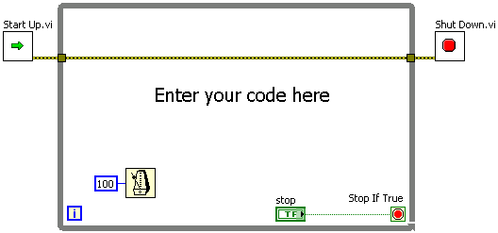
General VI Framework
Notes:
General VI Framework
DAQ常見的架構
Start UP用來初始化裝置 中間可以放入寫入或讀取等功能 Wait設定等待時間 在讀取或謝入時可以用來設定採樣率 Shut Down則是結束裝置
開範例程式Demo /Voltage On Demand Output

Slide 29
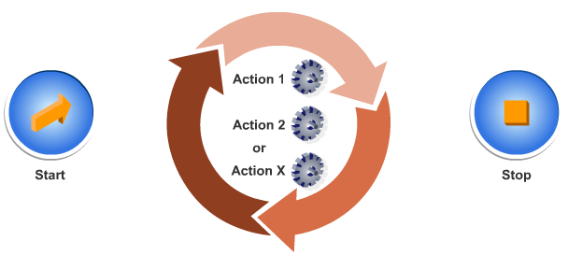
State Machine Pattern
Notes:
State Machine Pattern State machine有很多個動作，通常也含有start和stop
和General不同的是迴圈中包含多種狀態 各狀態有對應的執行程式 分為State Transition部分

Slide 30
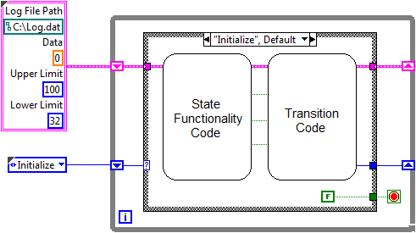
State Machine Framework
Notes:
除了要做完現在做的事情，還要決定接下來要做甚麼
State Machine Framework • While Loop 會有一個迴圈
要有case structure決定要進入的case • State data typedef and shift register –. 儲存下個state所需要的資訊 • State typedef and shift register – 控制要執行的下一個State • State functionality code –這一個狀態主要執行的程式 • Transition code –決定要進入哪一個狀態

Slide 31
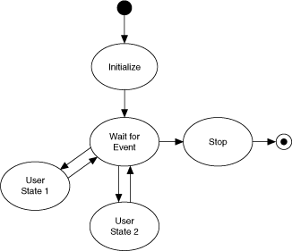
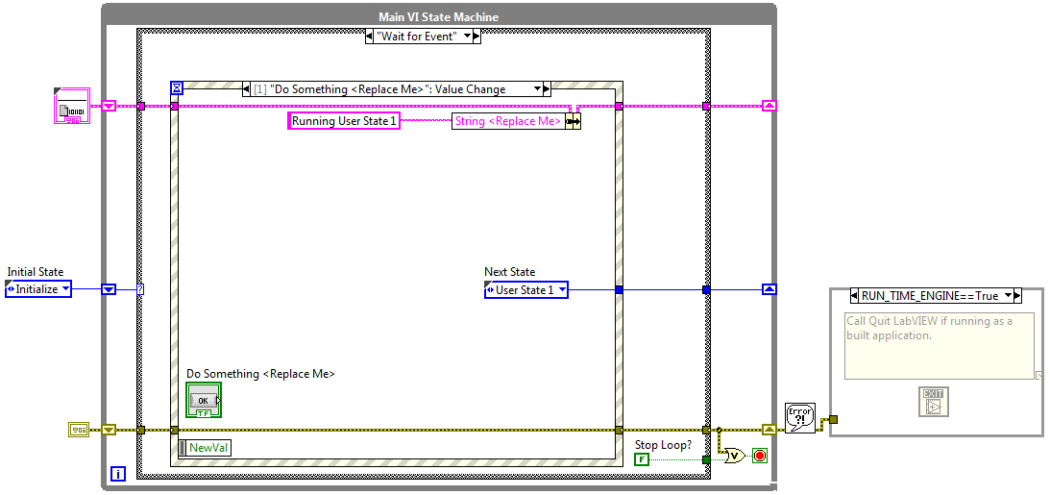
Event-Based State Machine
Notes:
Event-Based State Machine 用event 作為進入哪個狀態的依據 和Case-Based相似 Wait for Event等待事件觸發 以UI的Value Change來做為Transition

Slide 32
C. Multiple Loop Design Patterns
Use the producer/consumer (events) design pattern to create multiple loop applications.
Notes:
主要就是Producer/Consumer Loop的架構

Slide 33
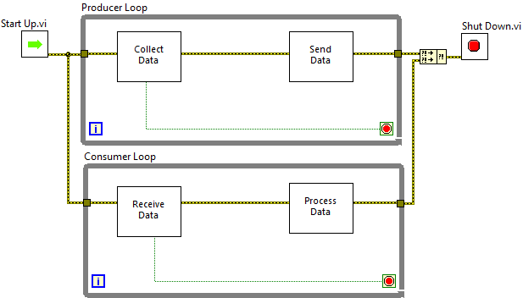
Producer/Consumer Design Pattern
Notes:
二個迴圈可以分別使用不同速率執行 一個產生資料，一個接收資料 使用queue或Notifier來在兩個迴圈中傳遞資料 如果使用queue，所以會有buffer來暫存資料，確保資料不會遺失

Slide 34
D. Functional Global Variable Design Pattern
Describe and use the functional global variable design pattern.
Functional Global Variables
Timer FGVs

Slide 35

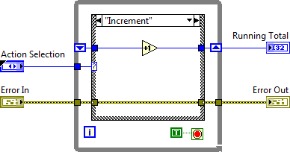
Functional Global Variable Design Pattern
Notes:
概念上類似Global Variable 可以讓其他VI呼叫 所以上面的架構如果在Main VI上就會是一個方塊
While loop 只執行一次（stop condition以True constant連接 所以被呼叫到的時候也只會執行一次
VI需具有non-reentrant的特性（VI property/execution/non-reentrant 也就是不能被同時呼叫
如此便可以避免Race condition的產生
FGV存取資料的方式是建立一個未定義初始值的shift registor （uninitialized shift registers ,USRs）
存取資料的過程包含三個狀態, initialize, read data, sent data initialize提供USR一個初始值,sent data與read data分別是改寫或著讀取USR的資料

Slide 36
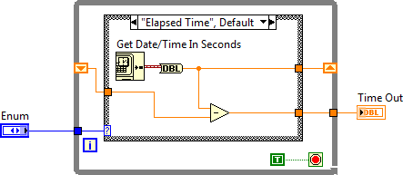
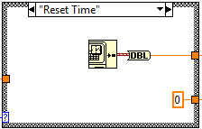
Timer FGVs
Notes:
設計一個簡單的elapsed time的VI，可以用來比較時間到底到了沒
Remember: 如果使用單一的方法來讀取FGV，就可以避免race condition
Reset Time Case利用 Shift Register把一開始的時間紀錄下來
Elapsed Time Case中取得當前時間資訊，和先前紀錄的起始時間相減即可得到經過的時間

Slide 37
Exercise Create a User Access Level FGV
建立一個Case, While loop, Case的三層架構, While設定為執行1次
建立Error Cluster連接到最外層Case, 並穿過整個架構
建立Enum存為Typedef, 包含Read User Access Level File, Set Current User, Get User Access Level
Read Case設定讀取User Access Levels.txt
Set Case設定讀取User Level
Get Case 直接穿過
完成FGV, 放入User Access Level FGV Unit Test.vi測試，根據不同Event改變Enum Value

Slide 38
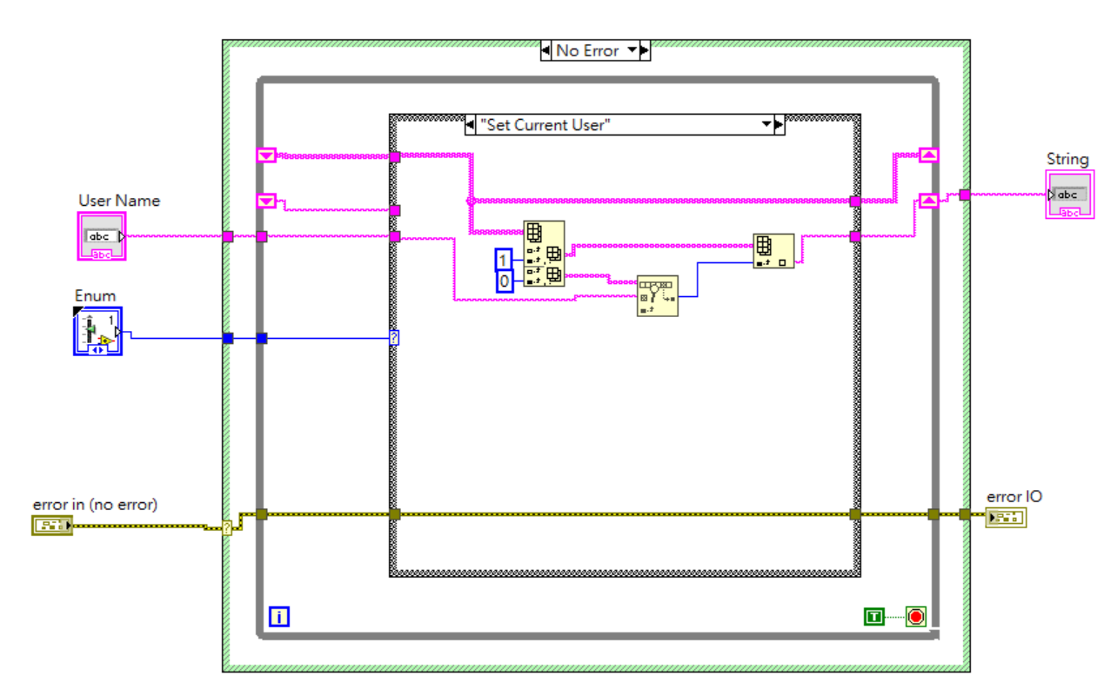
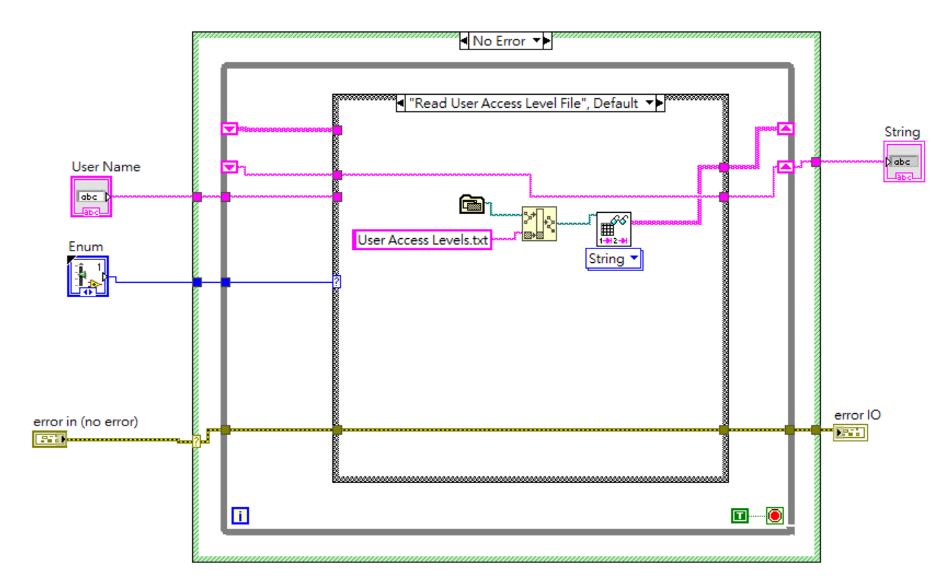
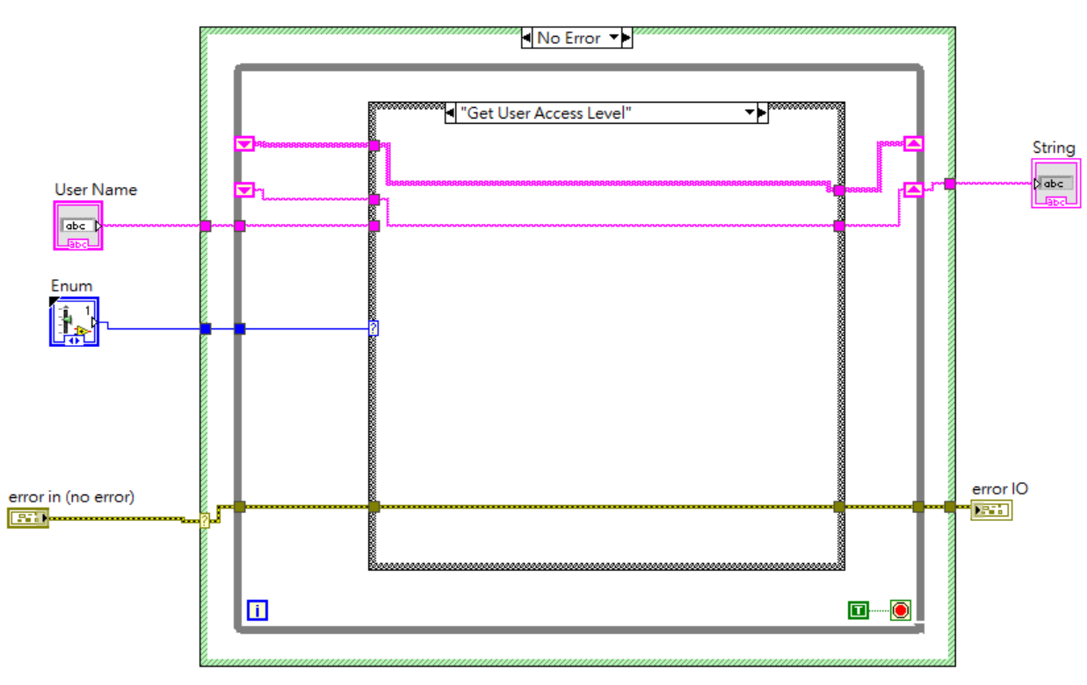
Exercise

Slide 39
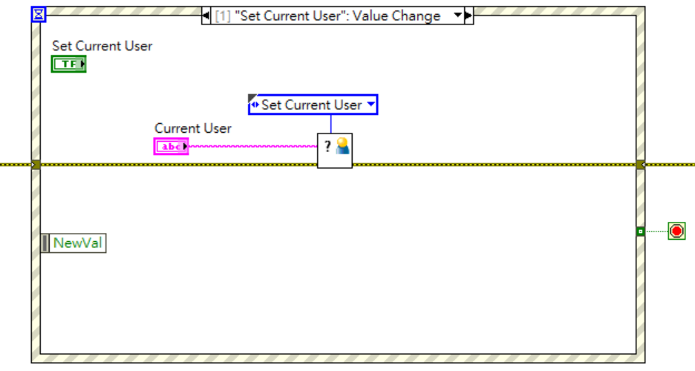
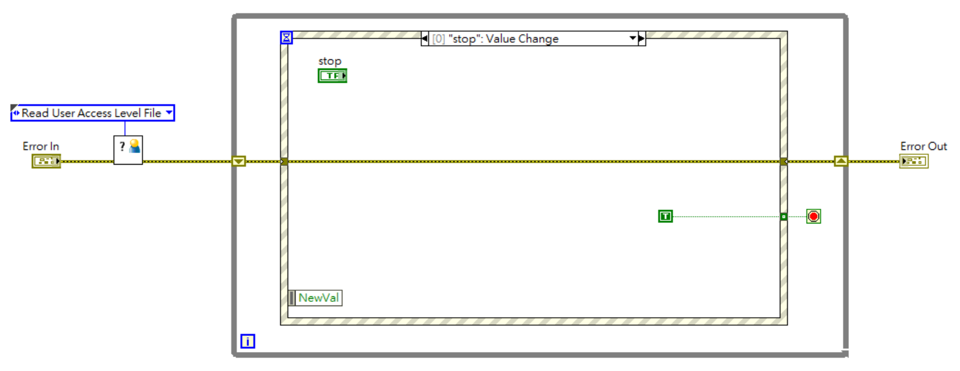
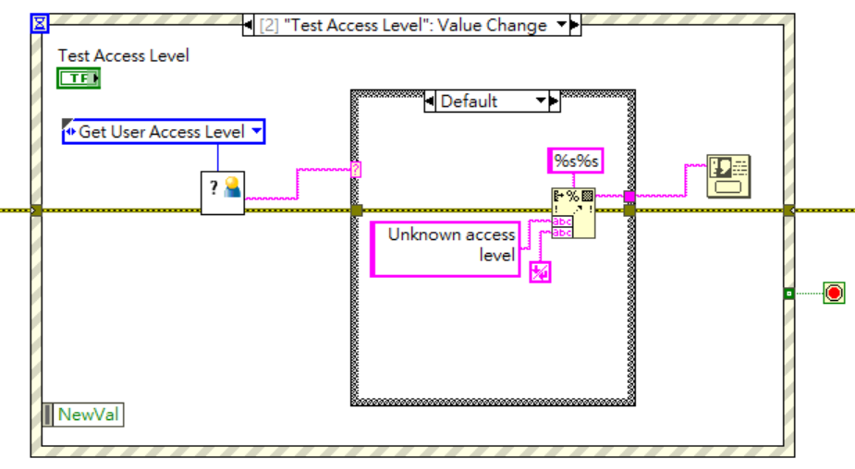
Exercise

Slide 40
E. Error Handlers
Use error handlers in design patterns to manage code execution when an error occurs.
Examples of Error Handlers

Slide 41


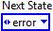
Examples of Error Handlers
Error Handler—A VI or code that changes normal flow of program execution when an error occurs
Simple Error Handler VI
General Error Handler VI
State machine error handler
Notes:
Definition: Error handlers在錯誤發生時會改變程式執行資料流的程式 Error handlers can be simple or elaborate. • Simple Error Handler VI:會跳出錯誤示窗 • General Error Handler VI—可以自訂義error • State machine error handler—.會跳到shutdown的那個state
更複雜的error handler會把錯誤訊息存檔，然後和其他迴圈或VI溝通，進而重開程式。
如果多個迴圈，我們可以一起停止

Slide 42
1. Which of the following are reasons for using a multiple loop design pattern?
Execute multiple tasks concurrently
Execute different states in a state machine
Execute tasks at different rates
Execute start up code, main loop, and shutdown code
Notes:
AC

Slide 43
1. Which of the following are reasons for using a multiple loop design pattern?
Execute multiple tasks concurrently
Execute different states in a state machine
Execute tasks at different rates
Execute start up code, main loop, and shutdown code

Slide 44
Source Code Control
Software that tracks changes to files
Stores all versions of files and their change records
Provides multiple developers access to files
Notes:
Source Code Control
可以追蹤過去修改過的歷程，並且將過去的所有版本都儲存
可以允許多位編輯者針對同一份程式進行修改，有助於大型專案的協作開發

Slide 45
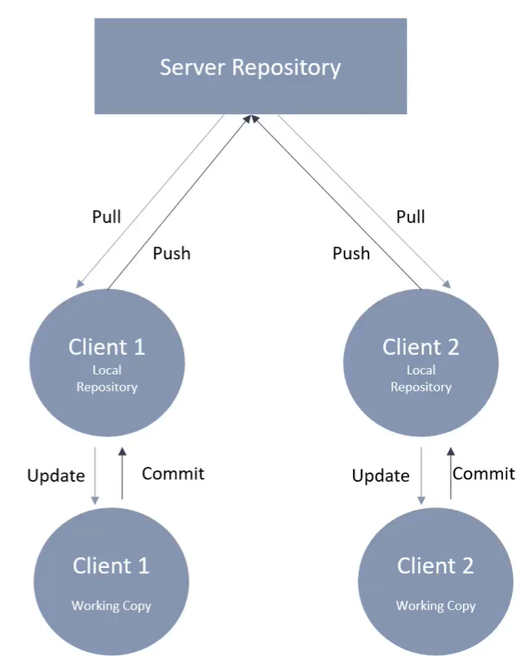
Distributed Version Control
Github
Tortoise Perforce
PC (LabVIEW)
Notes:
分散式Source Code Control架構
目前常見(EX: Github)
優點: 大家可以在自己的工作區各自修改，合併前再比較彼此差異
地端PC對程式進行修改commit給第三方SCC軟體，在SCC軟體進行compare, merge, history log等等 由第三方SCC軟體Push 到雲端Github

Slide 46
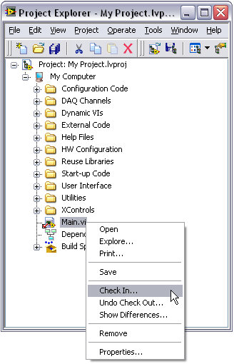
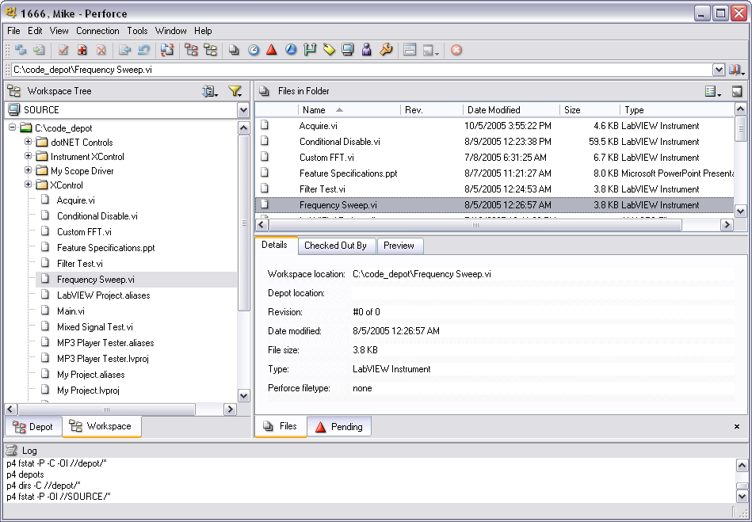
Source Code Control – Options
Use within LabVIEW Professional Development System
Use directly through a source code control tool
Notes:
Source Code Control – Options
LabVIEW專業版中可以透過Project Explorer使用Source Code Control的功能
或是也可以透過第三方的軟體做到(EX: Tortoise, Perforce等等)

Slide 47
Source Code Control – Integration with the LabVIEW Project
LabVIEW Project makes accessing SCC in LabVIEW simpler
Right-click one or more files to check in or out
Right-click and select Show Differences to view edits interactively (Perforce and VSS)
File icon shows current status
Checked in
Checked out
Notes:
Source Code Control – Integration with the LabVIEW Project
點擊右鍵可以將檔案CheckIn或CheckOut到Source Control System
也可以透過Show Difference來尋找修改過的部分 Project Expolorer可以查看檔案當前的狀態(EX: modified, CheckIn, CheckOut等等)

Slide 48

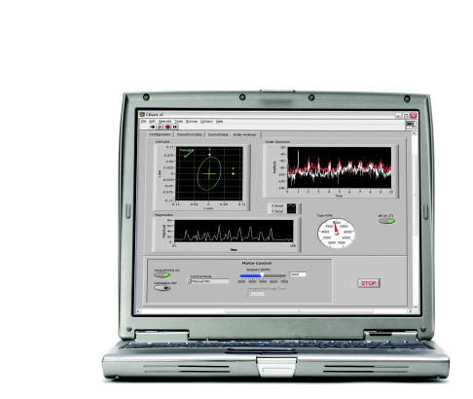
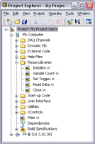
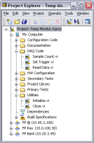
Source Code Control – Team-Based Development
Server stores all revisions of files
Project files
VIs
LLBs
Documents
Each developer can check copies of files in and out as needed
Notes:
Source Code Control – Team-Based Development
開發大型專案需要Team-Based Development
中央Server可以管理各種檔案與其各種版本
透過SCC每個開發者都可以在自己的工作區開發程式
SSC只允許同一時間只有一位開發者更動原檔案 完成編輯後將修改過後的檔案上傳到SCC供下一位開發者使用

Slide 49
Source Code Control – Branch and Merge
Branch—Split from the main development line to create a new version of the code
Notes:
Source Code Control – Branch and Merge
從Main產生Branch來創建一個新的版本
這樣的方式可以在不影響Main的情況下進行各種嘗試 直到經過驗證測試確定沒問題後再將Branch和Main合併即可

Slide 50
Source Code Control – Branch and Merge (continued)
Merge—Integrate the development split into the main development line
Notes:
Source Code Control – Branch and Merge (continued)
SCC提供自動化將多個Branch合併到Main 大幅度改善開發程序
各個Branch必須先經過詳盡的測試與驗證 最後的Main將是具備完整功能的程式了

Slide 51
Demonstration Source Code Control with Tortoise and Github
Install and configure a source code control system with LabVIEW to improve the configuration management of a project and learn common techniques of using a source code control system.
Notes:
事前需要先安裝Tortoise, Git
並且建立Github帳號 將Tortoise 和Github串聯
Show History, Compare, Merge

Slide 52

Thank you for kind attention~
Joe Kao
Solution Team
Industrial Intelligence BU
E: joe.kao@ecloudvalley.com

